Slide 1
Service Configuration Management

Slide 2
What is the purpose of Service Configuration Management?
PURPOSE: to ensure that accurate and reliable information about the configuration of services, and the CIs that support them, is available when and where it is needed
DEFINITION: A Configuration Item (CI) is any component that needs to be managed in order to deliver an IT service
CMDB (Configuration Management Database)
CI
CI
relationship
relationship
Attributes
1….
2….
3….
CI
relationship
relationship
CI
CI

Slide 3
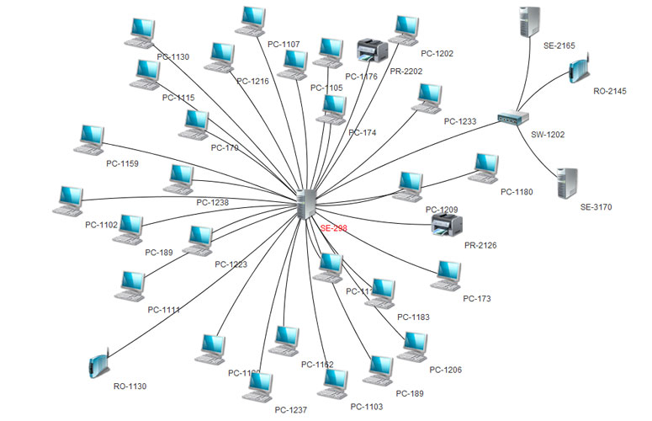
Key elements of the Service Configuration Management practice
The CMDB documents relationships and attributes
Could describe a variety of assets (e.g. hardware, software, documentation, people, skills, services, etc.)
A cost vs. benefit analysis is recommended
Configuration Management requires a very strict Change discipline

Slide 4
Release Management
Next Video

